Slide 1
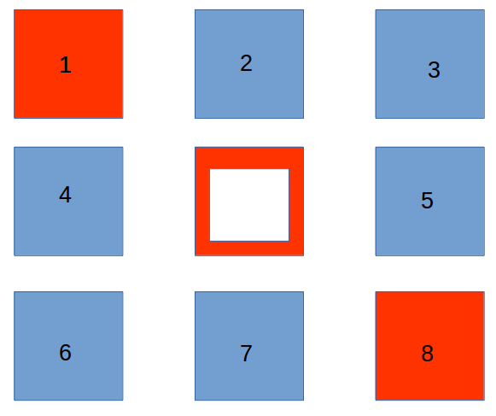
Source Image
im = cv2.imread("images/simple.png")

Slide 2
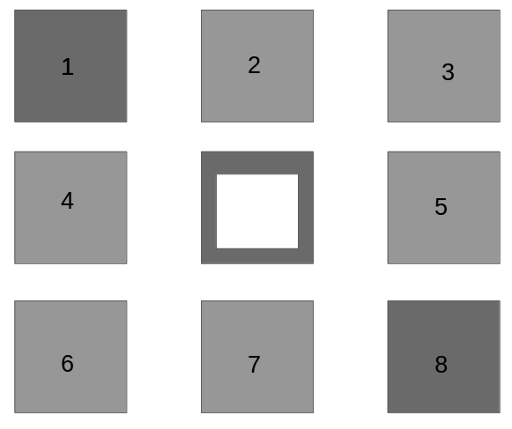
Converted to GS
gs =cv2.cvtColor(im,cv2.COLOR_BGR2GRAY)

Slide 3

Blurred (media filter)
blurred = cv2.medianBlur(gs, 5)

Slide 4

Thresholded
t =cv2.threshold(blurred, 155, 255, cv2.THRESH_BINARY_INV)

Slide 5
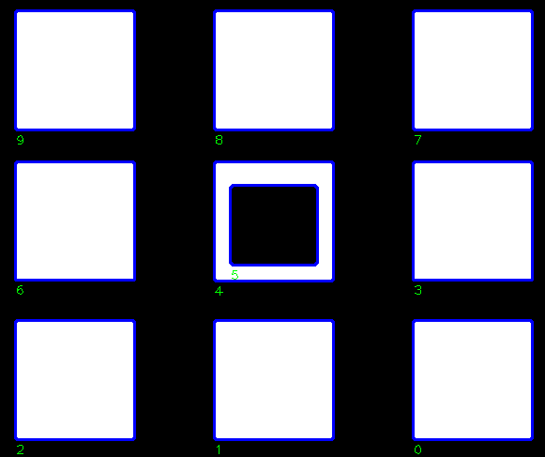
All contours traced
cv2.findContours(t, cv2.RETR_TREE, cv2.CHAIN_APPROX_SIMPLE)

Slide 6
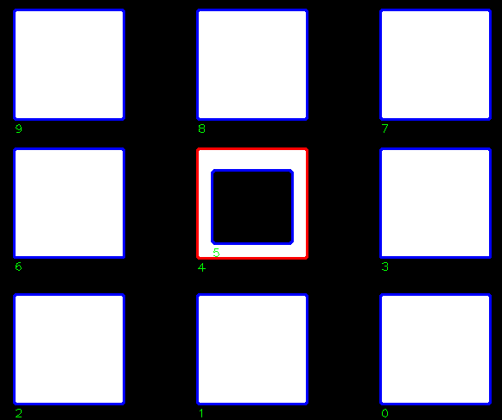
Select contours which have children
If num_children(cnt) > 0:

